Slide 1
IMAGE STEGANOGRAPHY
Created by:
Megha Magadumakar-2GI19IS024
Sanjana Sunadholi – 2GI19IS047
Shweta Naik-2GI19IS050
Tejaswini Naganoor-2GI19IS055

Slide 2
What is Steganography?
The word Steganography is derived from two Greek words- ‘stegos’ meaning ‘to cover’ and ‘grayfia’, meaning ‘writing’, thus translating to ‘covered writing’, or ‘hidden writing’.
“Steganography means hiding one piece of data within another”
Steganography is the technique of hiding secret data within an ordinary, non-secret, file or message in order to avoid detection

Slide 3
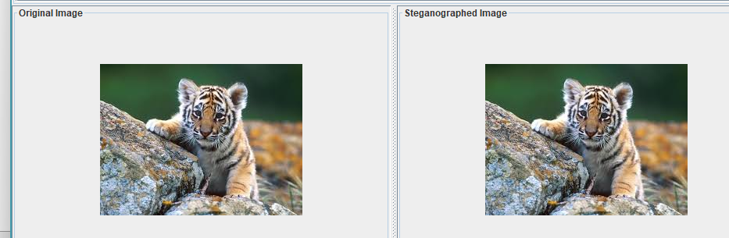
Image Steganography
Image steganography, is a type of steganography which entails concealing data by using an image of a different object as a cover.
In Image Steganography, images are first transformed then message is embedded in it using bit-wise methods, that apply bit insertion and noise manipulation.

Slide 4
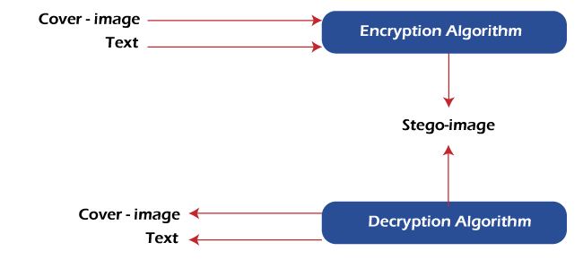
Methodology

Slide 5
Demonstration->

Slide 6
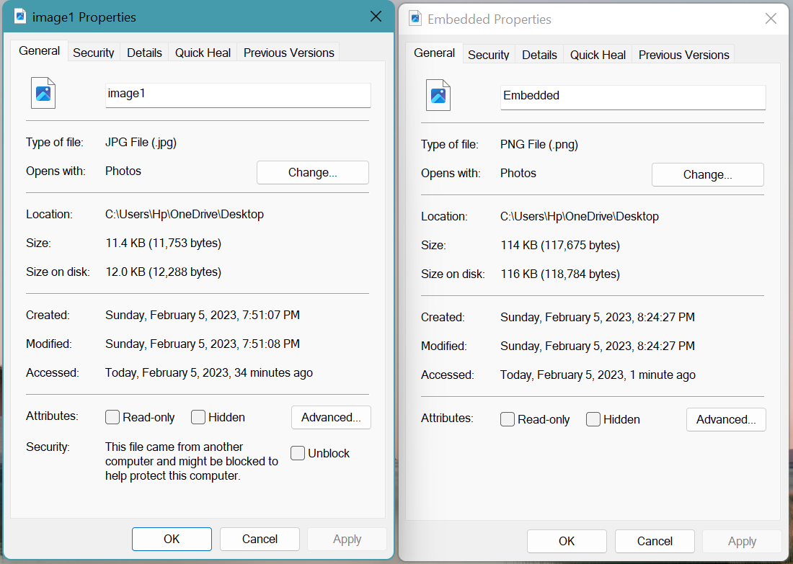
Original Image Vs Stego-Image

Slide 7
Applications
Defense organization: security from enemies
Intelligence Agencies: security of person's private information
Government Agencies: store critical data like criminal record
Smart identity cards: personal information is embedded into photo
Medical: patient's details are embedded within image

Slide 8
Thank You ☺

